Slide 1
DARIAH-HR Digital Tools
in the Frame of Open Science
PUBMET2023: The 10th Conference on Scholarly Communication in the Context of Open Science
13-15 September 2023, University of Zadar, Croatia
Koraljka Kuzman Šlogar
Anamarija Žugić Borić
Institute of Ethnology and Folklore Research, Zagreb

Slide 2
Development of the tools…
… in the partnership with
institutions within the DARIAH-HR national network
other members of the DARIAH-EU consortium

Slide 3
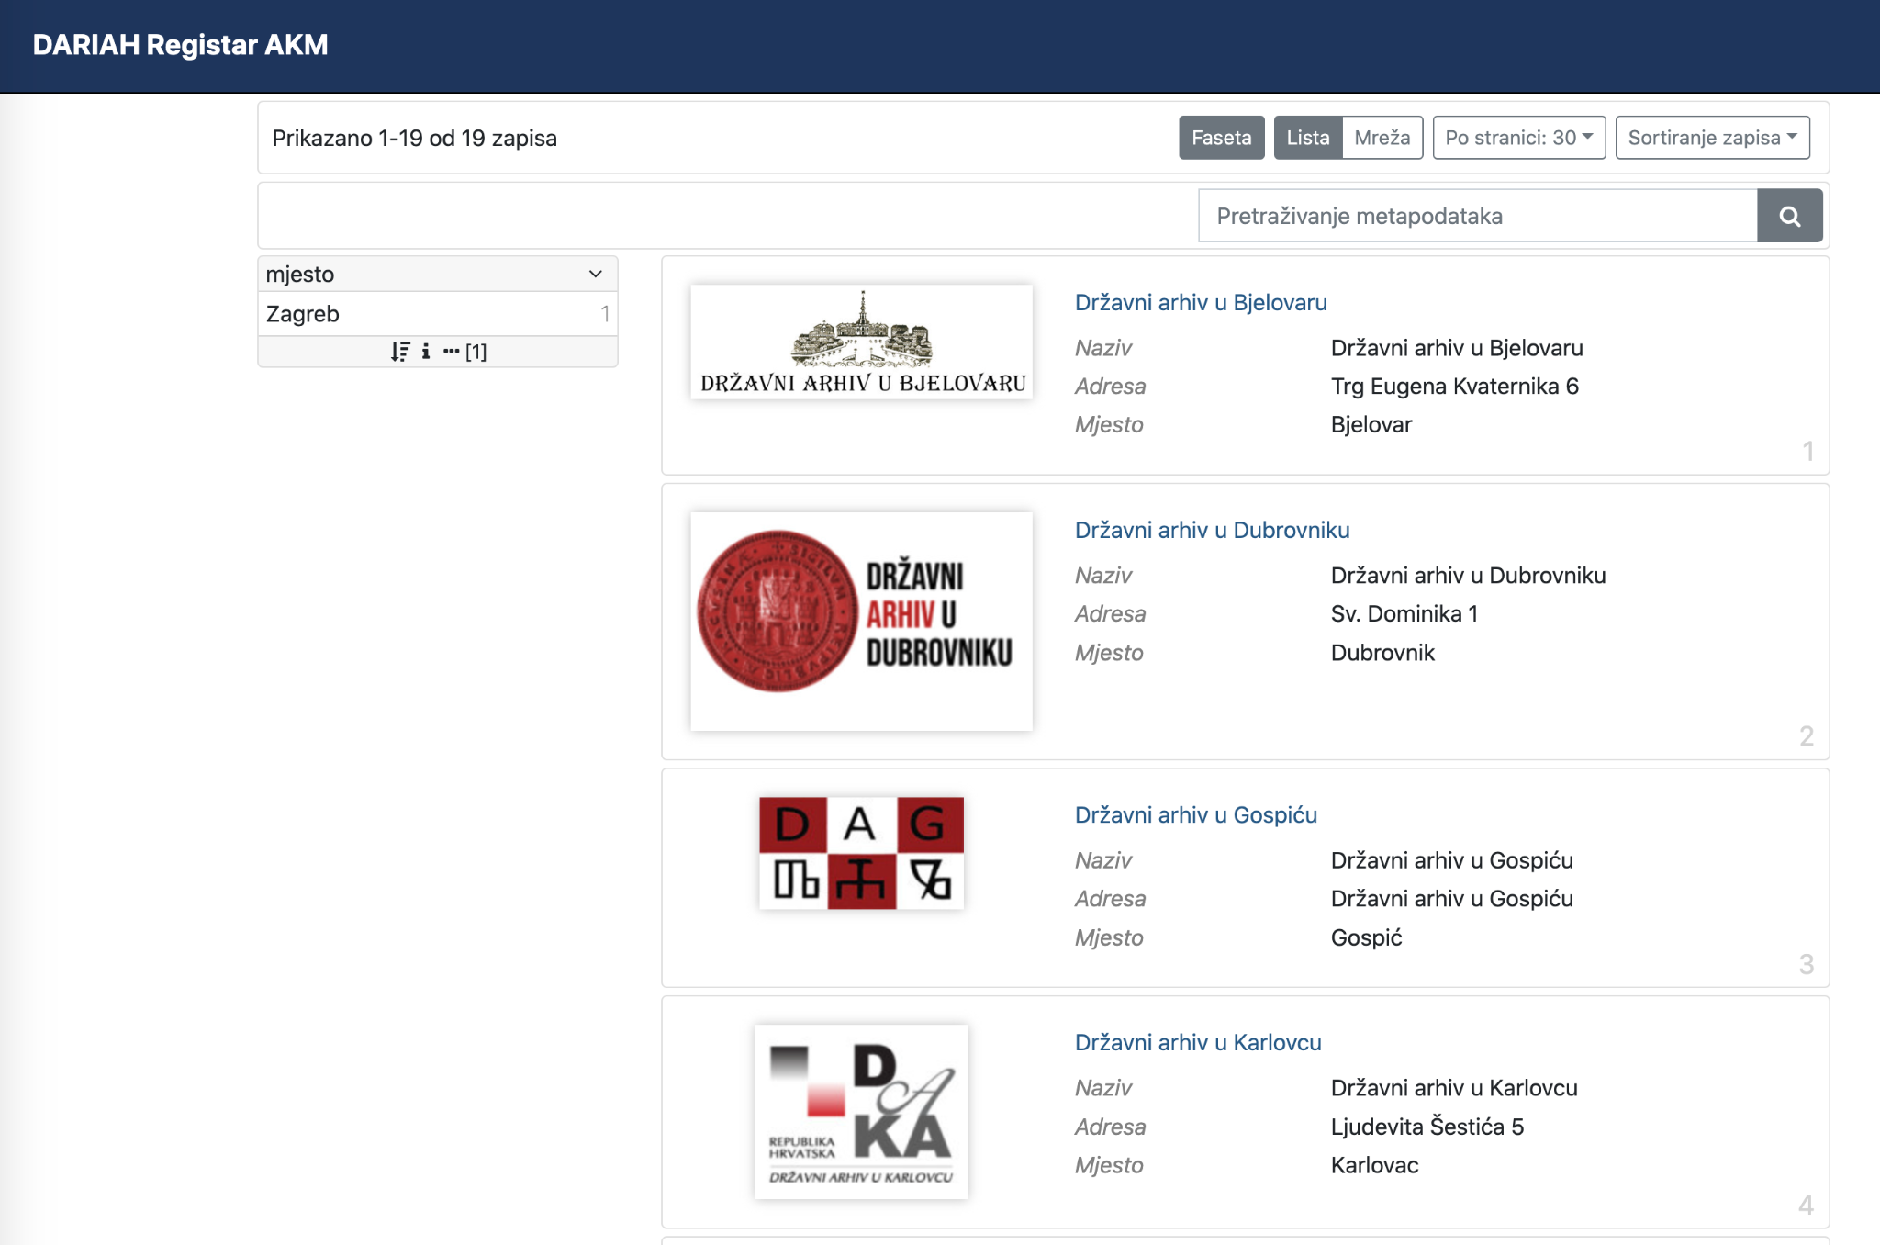
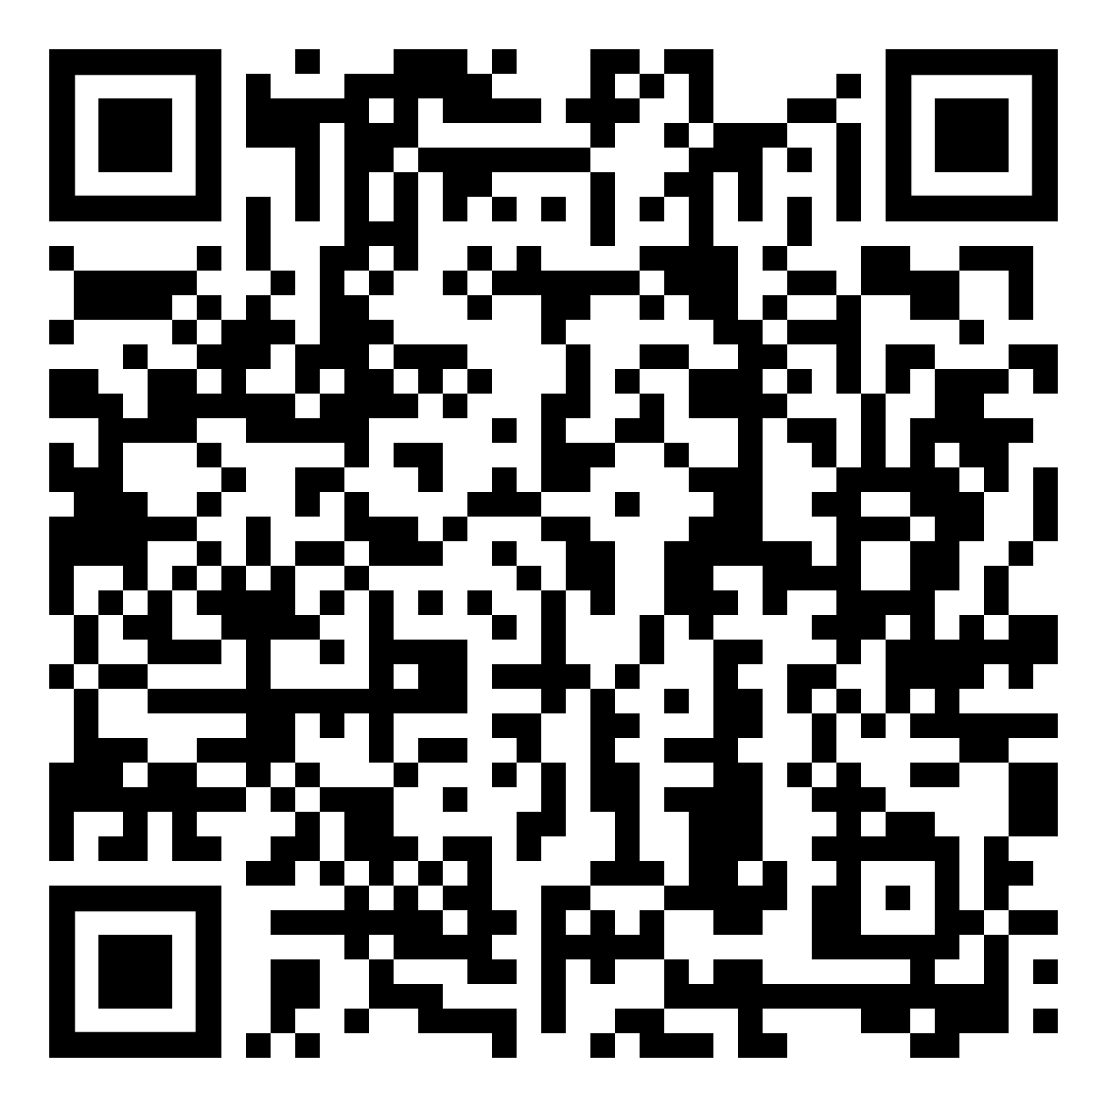
DH register
A unique national platform designed to facilitate the creation of relevant registers for institutions operating in the fields of humanities, arts and culture, as well as provide information about humanities research projects, digitization projects, digital collections, digital tools, and other related content.
Become a collaborator

Slide 4
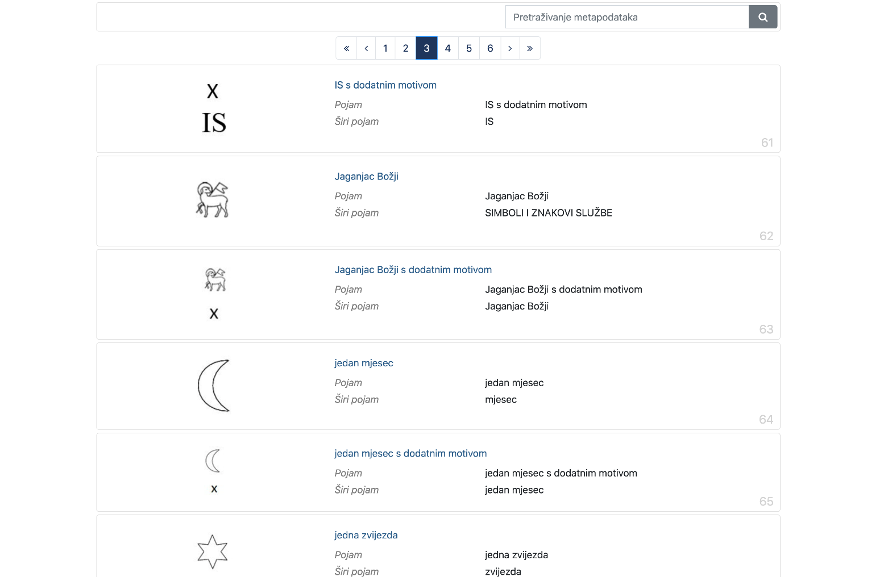
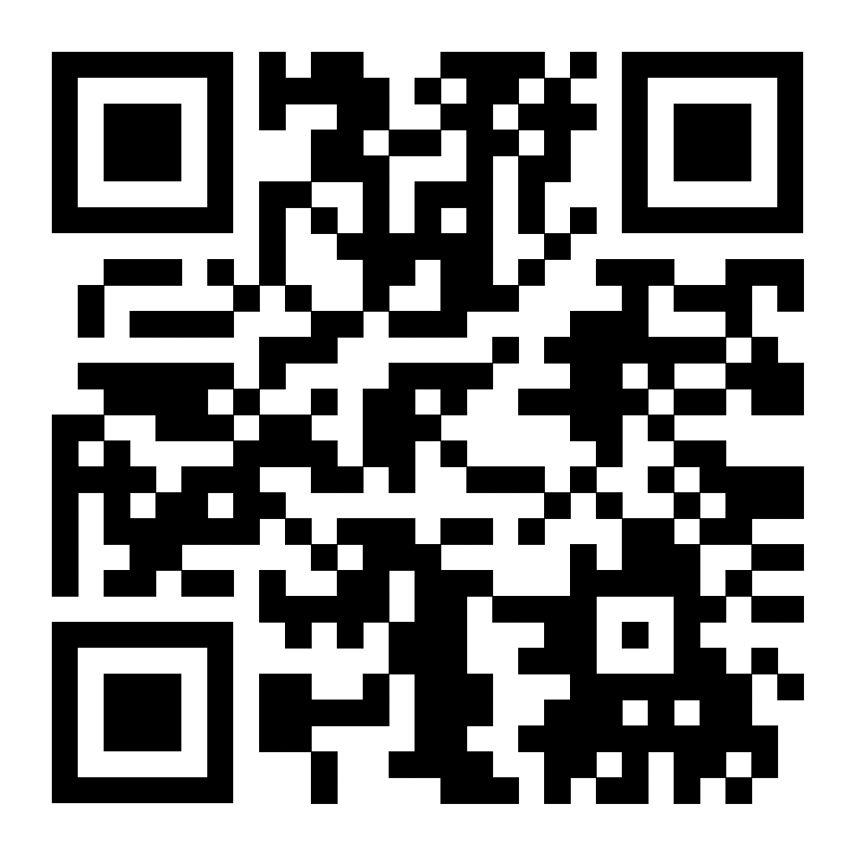
Tezaurus.hr
A platform conceived as a database for all dictionaries which can be used in various domains (within the digital humanities and beyond). Tezaurus.hr supports the integration of various metadata standards and dictionaries from recognized sources like Getty Thesaurus and Geospatial Thesaurus.
Become a collaborator

Slide 5
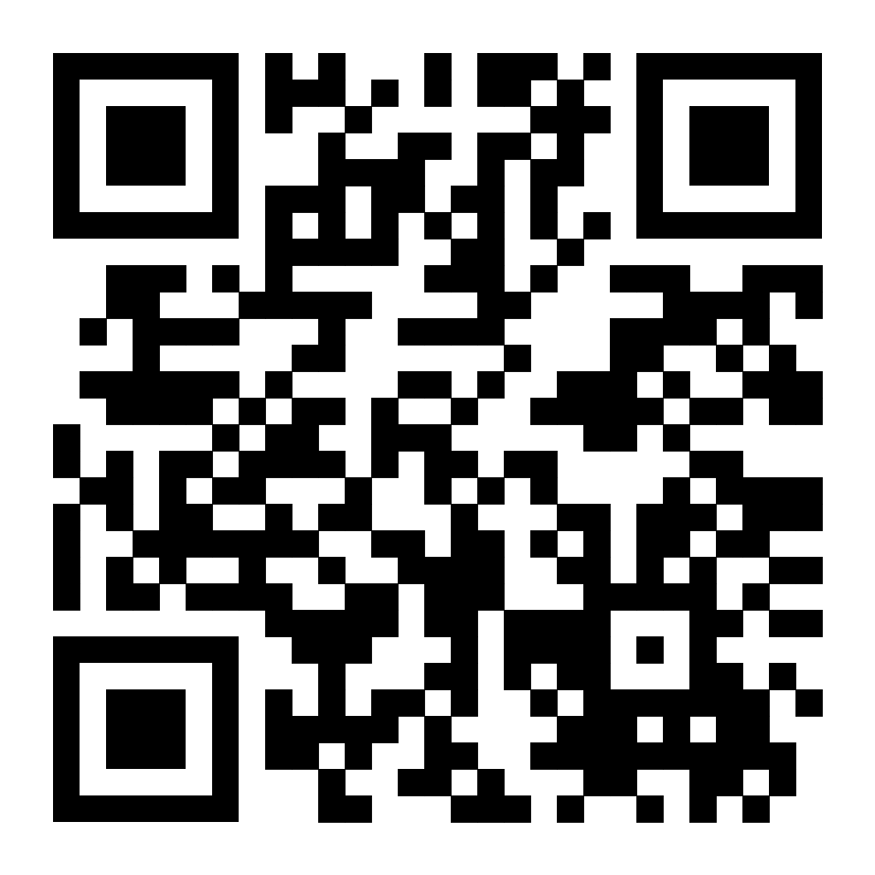
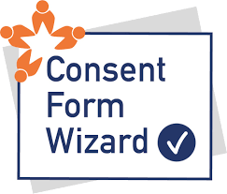
Consent Form Wizard
The aim of the CFW is to assist humanities researchers in obtaining GDPR-compliant data processing consent. To generate ready-to-use consent form templates, CFW employs a questionnaire-based approach. The tool was created by the DARIAH-EU ELDAH working group and is available in seven languages.
Test the tool here

Slide 6
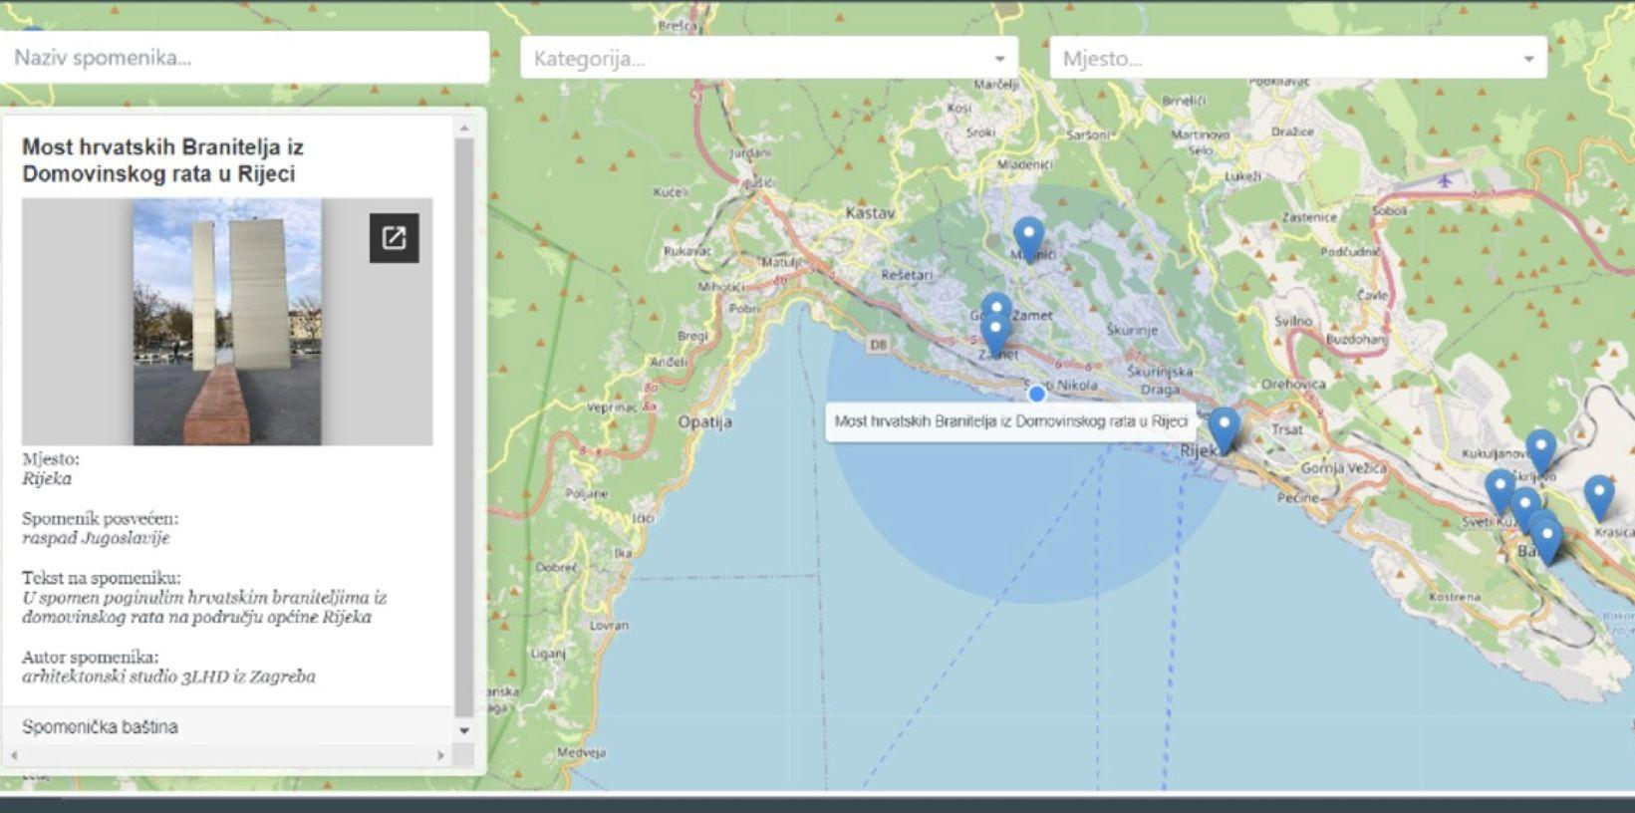
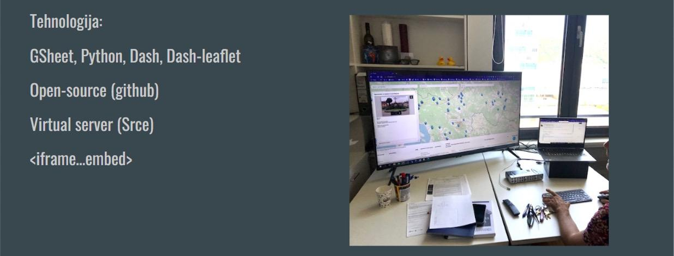
Monument Heritage Map
An open-source tool for data collection, processing, visualization, and mapping of cultural monuments. The tool aims to involve students and the general public through a citizen-based science approach.

Slide 7
Benefits
improving knowledge organization, promoting resource sharing, fostering collaboration, and encouraging responsible research practices
creating an open ecosystem rooted in genuine community needs and practices
practically addressing the imbalance between STEM and Humanities disciplines in Open Science trends
developing a robust, interconnected research infrastructure

Slide 8
dr. sc. Koraljka Kuzman Šlogar; koraljka@ief.hr
Anamarija Žugić Borić; zugicboric@ief.hr
Institute of Ethnology and Folklore Research
DARIAH-HR
____
Šubićeva 42, 10 000 Zagreb
Tel. +385 (0)1 459 67 41
Fax. +385 (0)1 459 67 09

