Slide 1







THE OPENAIRE TOOL FOR BRIDGING REGISTRIES OF RESEARCH ORGANIZATIONS
Claudio Atzori, Gina Pavone
Institute of Information Science and Technologies, Italy
Ivana Končić, Bojan Macan
Ruđer Bošković Institute, Croatia
  Ruđer Bošković Institute

Slide 2






IN THE WORLD OF SCHOLARLY COMMUNICATION, IDENTIFYING RESEARCH-RELATED ENTITIES CAN BE LIKE NAVIGATING A COMPLEX LABYRINTH.
Ambiguity in organization names, varied metadata, and multiple PID schemas create many challenges and efficiency issues in information sharing and discoverability...
  Ruđer Bošković Institute

Slide 3

  BUILDING A CONNECTED OPEN SCHOLARLY COMMUNICATION SYSTEM
  Meet OpenOrgs, an OpenAIRE tool designed to untangle the web of research organizations.
  Data sources include ROR, repositories, journals, CRIS systems, and more.
  The result: fueling the dynamic OpenAIRE Graph.
  Ruđer Bošković Institute

Slide 4
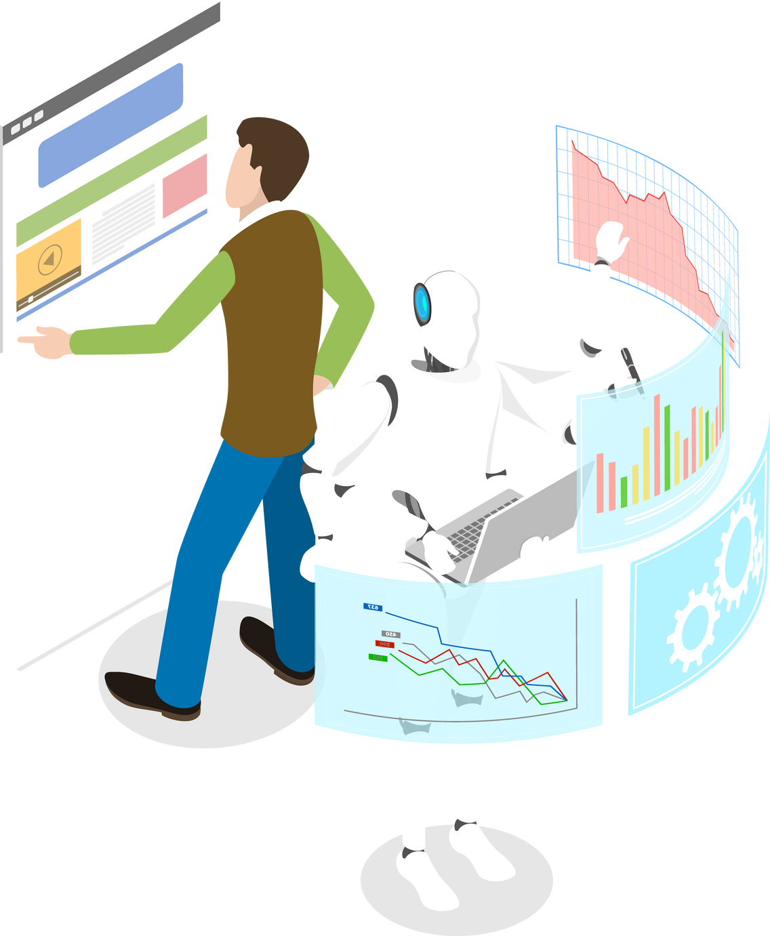

  AUTOMATION MEETS HUMAN EXPERTISE
How does OpenOrgs work?
  First, a deduplication algorithm detects similarities between organizations across multiple sources using metadata such as names, URLs, and countries.
  Then comes the human touch - dedicated data curators step in to verify, clarify, and enrich organization records.
  Over 70 data curators worldwide have joined this collaborative effort, resulting in over 100,000 curated organizations.
  Ruđer Bošković Institute

Slide 5

  POWER TO THE PLAYERS - BENEFITS FOR ALL
  OpenOrgs brings benefits to researchers, RPOs, RFOs, and other Open Science stakeholders.
  Boosts findability of digital objects for researchers.
  Showcases scientific production consistently for RPOs.
  Offers impact insights for RFOs.
  Up-to-date services for all Open Science champions.
  Ruđer Bošković Institute

Slide 6
  OPENORGS’ ROLE IN THE OPENAIRE ECOSYSTEM
  OpenAIRE Graph is enriched by OpenOrgs through the creation of representative organizations.
  OpenAIRE Explore showcases curated metadata from OpenOrgs, providing researchers with swift access to organization details.
  OpenOrgs fuels the OpenAIRE Monitor, tracking research activities and OS trends, further boosting the visibility of organizations and fostering collaboration.
  Ruđer Bošković Institute

Slide 7
  A GAME-CHANGER
  OpenOrgs isn't just a tool.
  It's a stride toward an integrated open scholarly communication system that will reshape collaboration, discovery, and engagement with research.
  Ruđer Bošković Institute

Slide 8
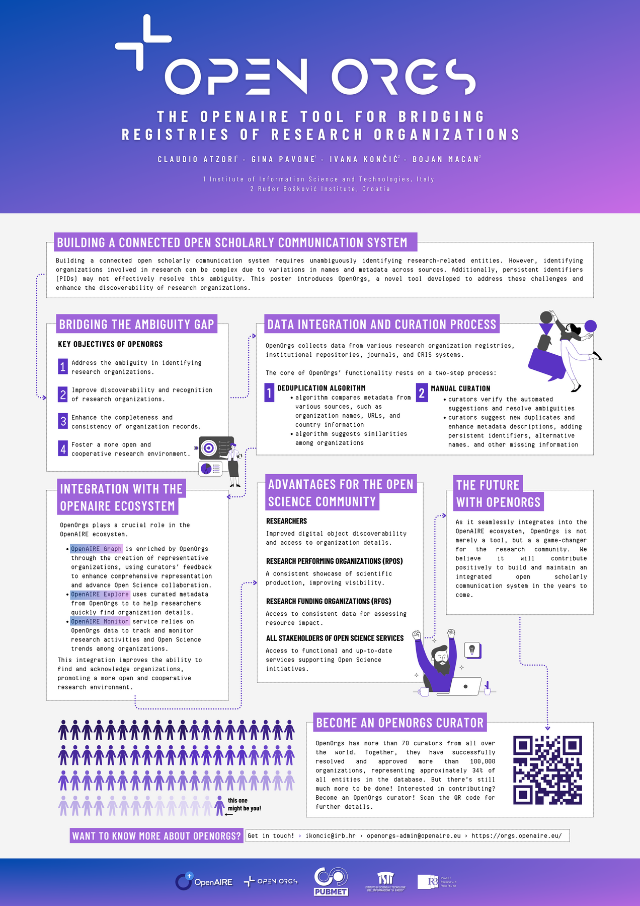
  WANT TO KNOW MORE?
Meet me at the poster! :)
Ivana Končić
Centre for Scientific Information
Ruđer Bošković Institute
e-mail: ikoncic@irb.hr
  Ruđer Bošković Institute

