Slide 1



PATTERN of Open Science in Croatia
Sanja Jurković; Bojan Macan
Ruđer Bošković Institute
PUBMET 2023
The 10th Conference on Scholarly Communication in the Context of Open Science
Funded by
the European Union

Slide 2






PATTERN Project
Full name
Collaboration
Piloting open and responsible Activities and Trainings Towards the Enhancement of Researchers Networks
19 organizations
13 European countries
Financed by
Duration
the European Commission
under the Horizon Europe programme
42 months
(January 2023 - June 2026)
Funded by
the European Union
‹#›

Slide 3


PATTERN Aim
To promote the practice of Open and Responsible Research and Innovation (Open RRI) by developing and piloting training activities for researchers at all stages of their careers.
Funded by
the European Union
‹#›

Slide 4
PATTERN Aim
and Methodology
To promote the practice of Open and Responsible Research and Innovation (Open RRI) by developing and piloting training activities for researchers at all stages of their careers.
The project's implementation began by systematic mapping and analysis of educational opportunities for researchers on Open RRI, which is followed by the development of curricula with an emphasis on inclusivity and fairness, whose implementation and testing are done through a variety of activities in pilot institutions across Europe.
Funded by
the European Union
‹#›

Slide 5
PATTERN training modules and targets
  8 training modules for researchers on transferable skills that support researcher’s career development, improve research capacities and stimulate innovation
    open access
    FAIR data management
    citizen science
    research integrity
    gender, non-discrimination and inclusion in research
    dissemination and exploitation of results
    science communication (towards media and policy-makers)
    management and leadership (managing emotions; achieving success with less stress; leadership in research etc.)
PATTERN targets
Researchers
Policymakers
Higher Education Instutions (HEI)
Civil society
will benefit from the training
will influence the training organization in HEIs
will deliver the trainings
will interact with researchers
Funded by
the European Union
‹#›

Slide 6

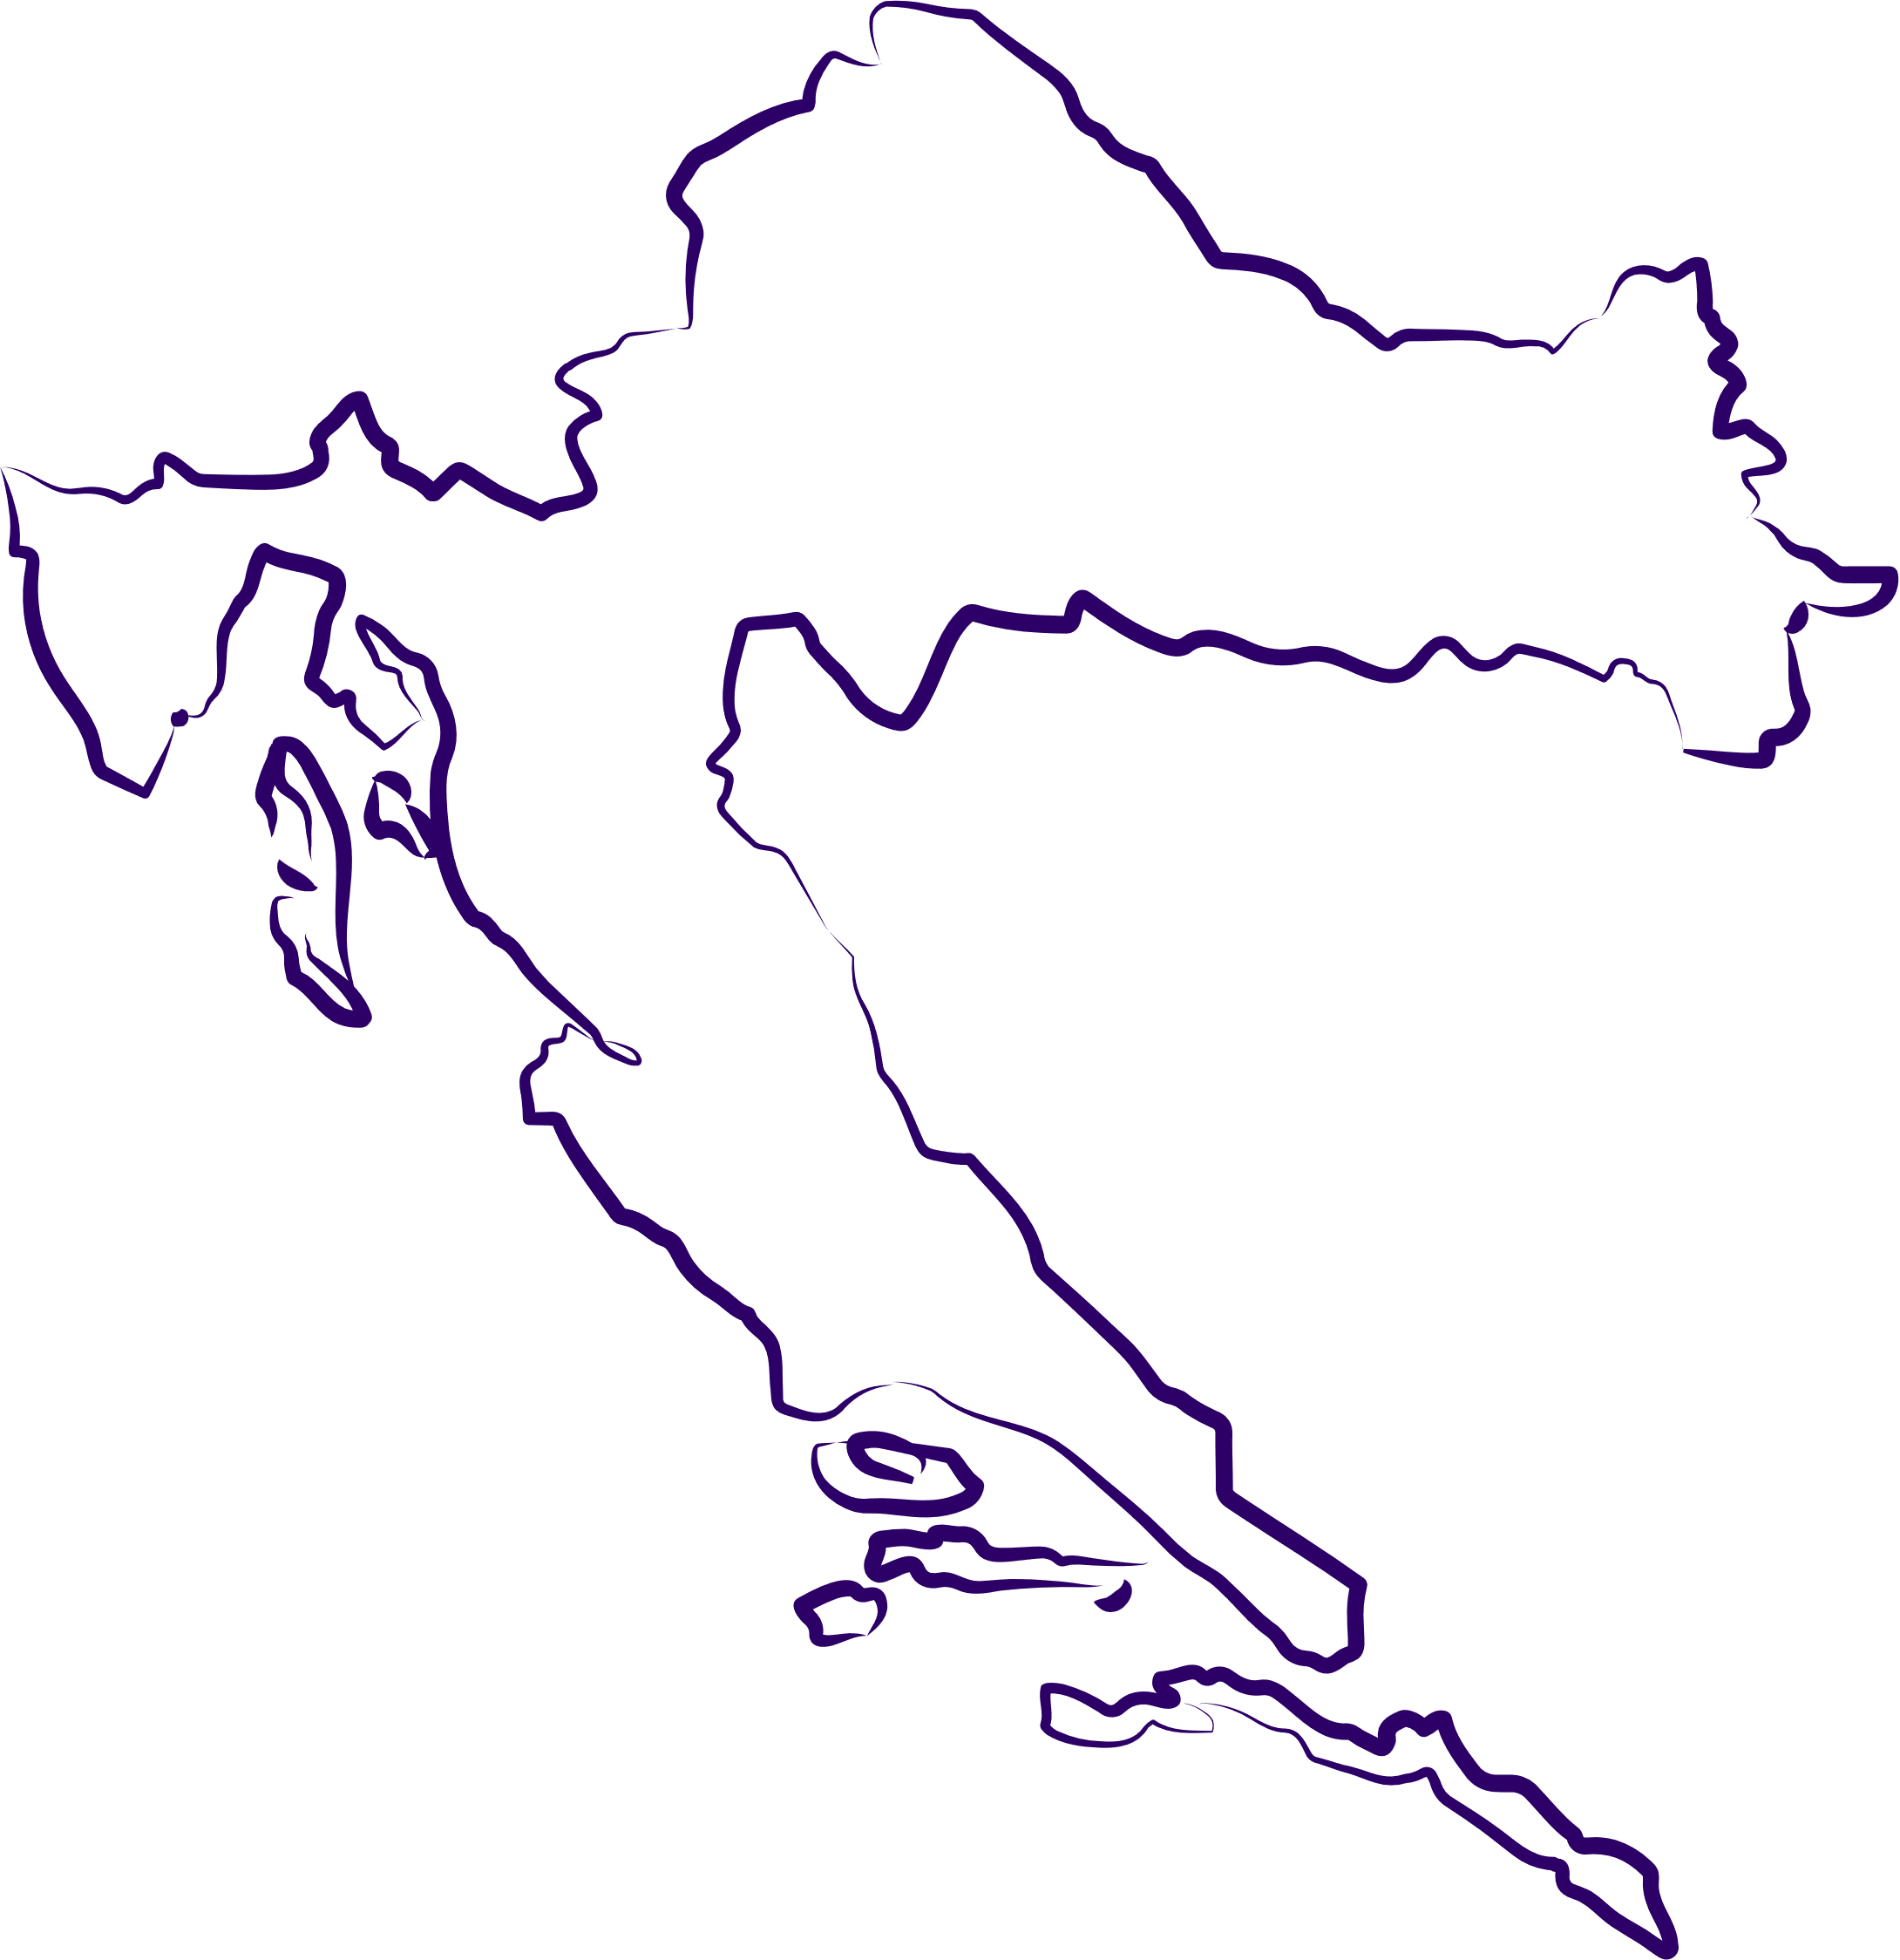
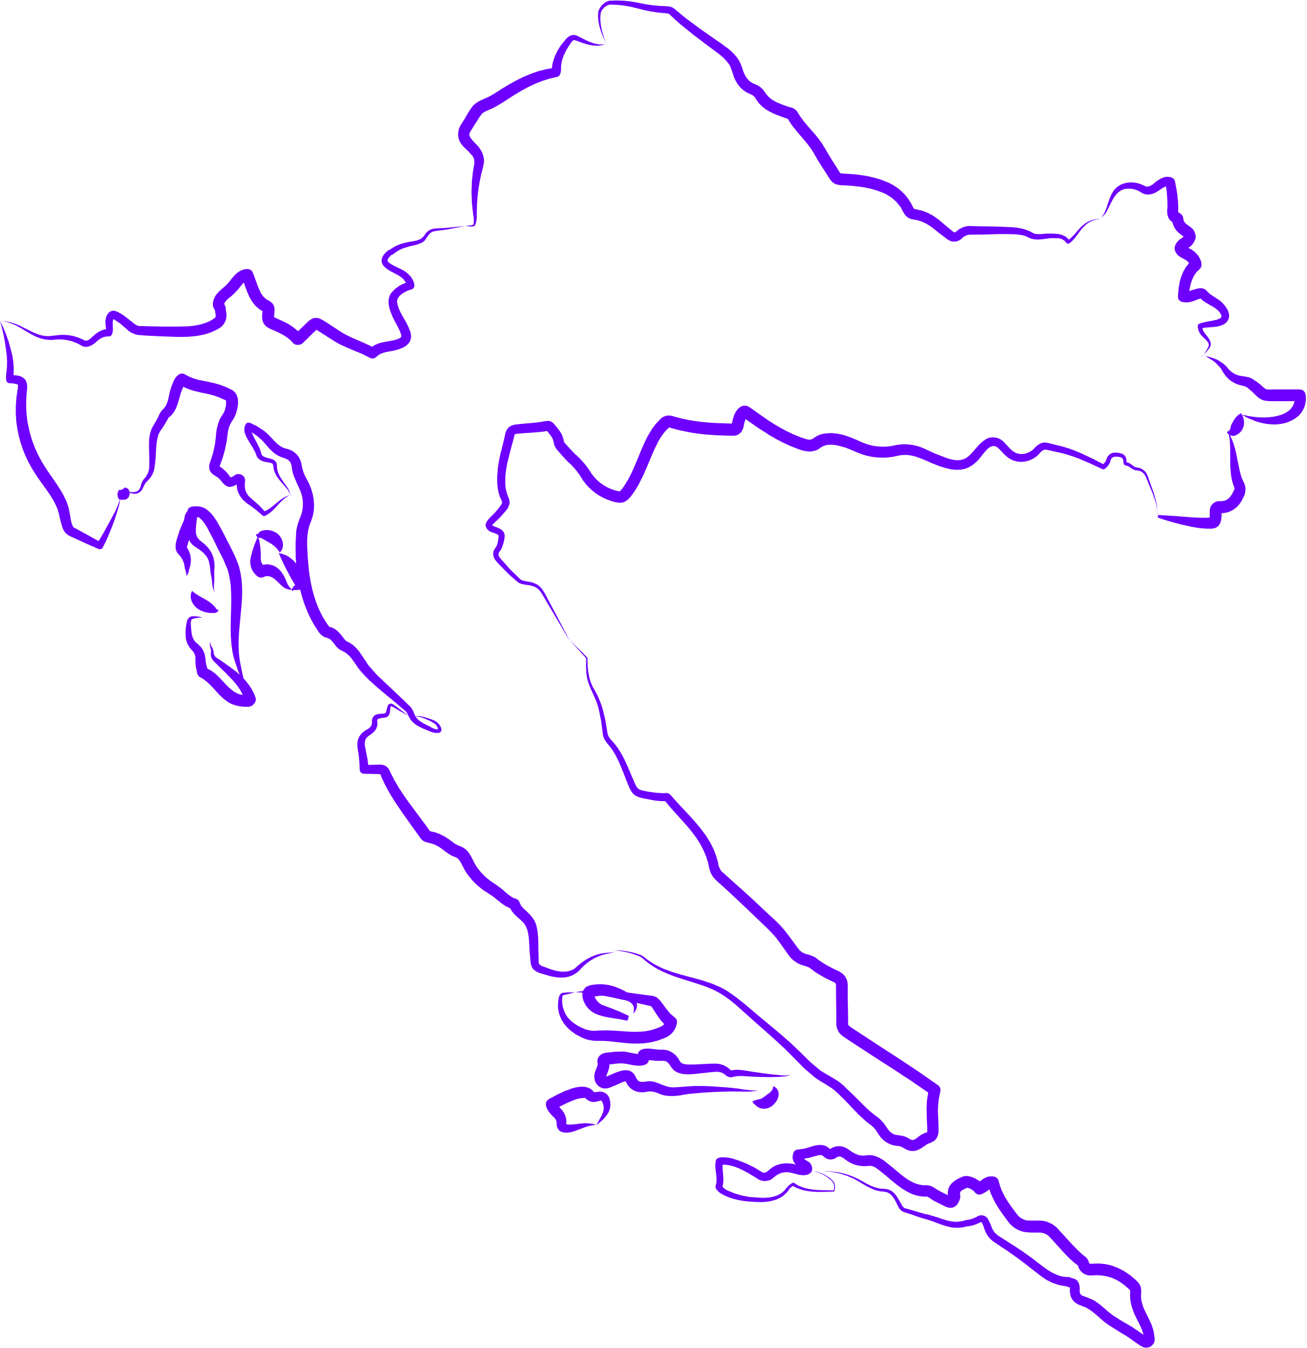

What does
mean for Croatia?
  there’s a continuous need for the training and promotion of OS topics among researchers
  lack of formal OS education at Croatian higher education institutions
  trainings at institutional and national level through various EU projects (OpenAIRE, FOSTER, NI4OS-Europe, CESSDA-SaW ... )
  p﻿lan for usage of OpenPlato to share OS training materials and courses in Croatian
  PATTERN represents a shift in training organization
  accumulating knowledge and expertise for developing comprehensive training programs
  significant contribution to science and society in the ERA
Funded by
the European Union

Slide 7
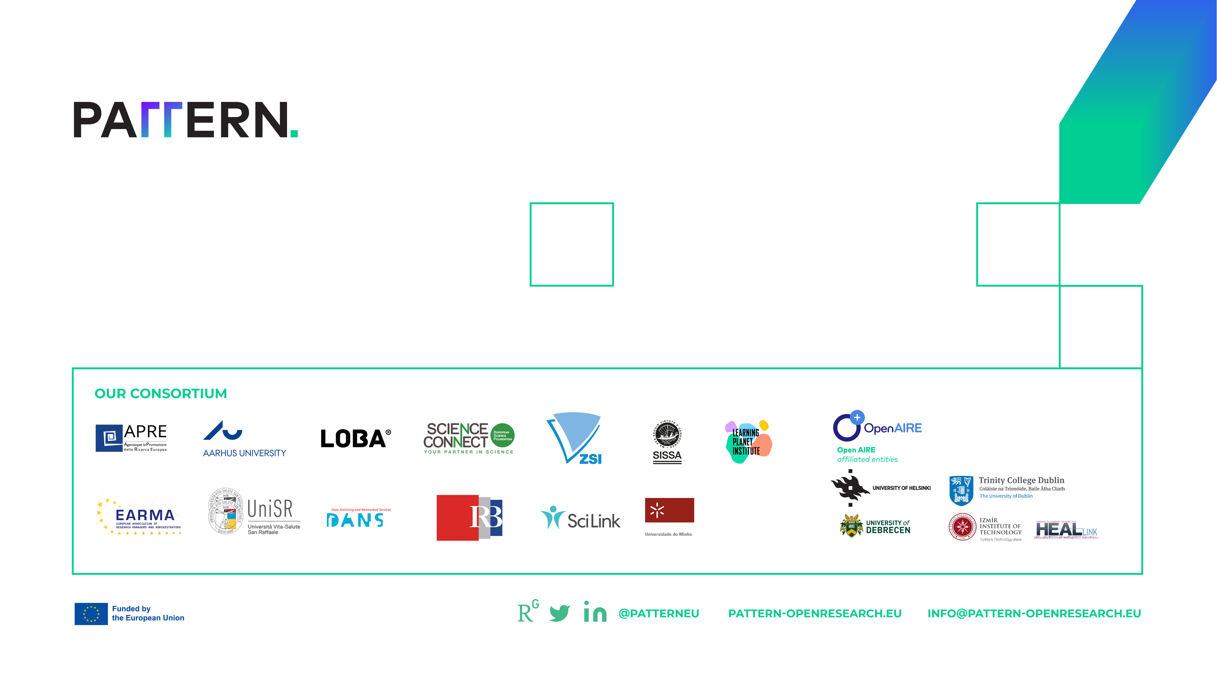
Sanja Jurković
Librarian at the Centre for Scientific Information
Ruđer Bošković Institute
Bijenička cesta 54, 10000 Zagreb, Croatia
e-mail: sjurkov@irb.hr
Thank you!

