Slide 1
Bibliometric indicators of Croatian clinical medicine research after joining the EU: interrupted time series analysis
Romana Jadrijević^{1,2}, Antonija Mijatović³, Ana Marušić^{1,3}
1 University of Split School of Medicine, TRIBE Ph.D. program 2 University Hospital of Split, Science Department 3 University of Split School of Medicine, Center for Evidence-based Medicine
Pubmet2023 Zadar, 14 September 2023.

Slide 2
Aim
To test the hypothesis that the number and quality of publications by Croatian authors in the field of clinical medicine has increased after Croatia joined the EU.
Corresponding author: Romana Jadrijević, rjadrijevic@kbsplit.hr

Slide 3
Methods
Sample
All publications with a Croatian affiliation (2005-2022):
Web of Science: Core Collection (n=113,695)
Scopus (n=122,932).
Minimal sample size
(0.05, 95%) = 385
Aim: include all publications in clinical medicine
Defining clinical medicine for database search
Public domain records
List of all possible names in clinical medicine
Gather
Group by shared relevant words
Truncate where possible
Combine with Croatia in the address field
Bibliometric data
Inbuilt export for two time periods: 2005-2013 and 2014-2022.
Indicators for comparison:
number of authors,
number of publications,
times cited (total, total without self-citations, self-citations),
average citation count per item,
h-index,
number and % of journal articles and review articles.
Statistical methods
Interrupted time-series analysis (ITSA)
via Python and Ordinary Least Squares method
Pre- and post-intervention coefficients and change in slope of the annual value of indices
Corresponding author: Romana Jadrijević, rjadrijevic@kbsplit.hr

Slide 4
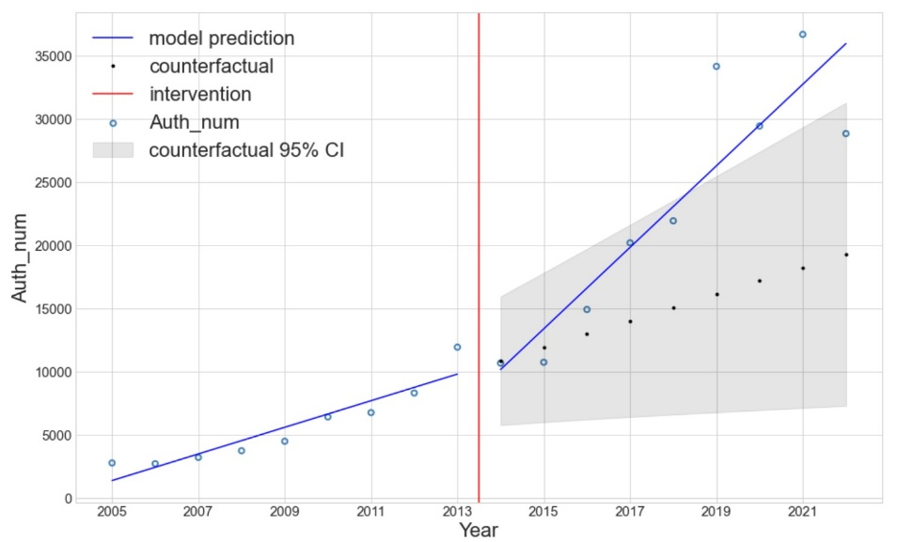
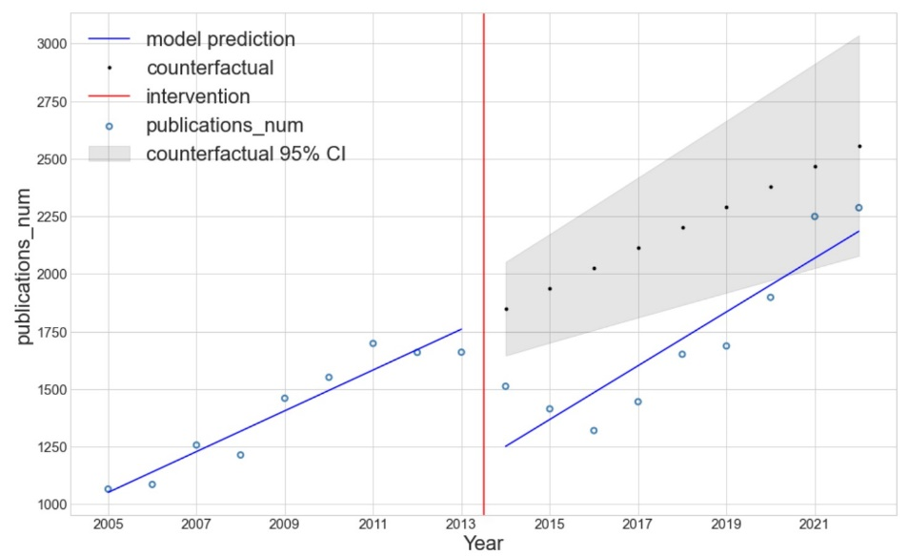
Results and Discussion
EU membership may be used to predict:
93.2 % of author number increase in WoS:CC,
95.7 % (WoS:CC) or 87.9 % (Scopus) of publication number,
95.2 % (WoS:CC) or 88.7 % (Scopus) of journal articles and reviews.
No citation-related indicators showed increase significantly related to the intervention.
Number of authors (WoS: CC)
Number of publications (Scopus)
* All graphs and full abstract available at the institutional repository of the University Hospital of Split.
Corresponding author: Romana Jadrijević, rjadrijevic@kbsplit.hr

Slide 5
Conclusion
A positive impact of EU membership may help:
Croatia’s decision-makers when deciding on joining other such communities,
decision-makers in similar countries when deciding whether to join the EU or not
might instigate others to conduct similar studies to see the full impact of formal international relations on science and scientific production.
Corresponding author: Romana Jadrijević, rjadrijevic@kbsplit.hr

Slide 6
Thank you!
Bibliometric indicators of Croatian clinical medicine research after joining the EU: interrupted time series analysis
Romana Jadrijević^{1,2}, Antonija Mijatović³, Ana Marušić^{1,3}
1 University of Split School of Medicine, TRIBE Ph.D. program 2 University Hospital of Split, Science Department 3 University of Split School of Medicine, Center for Evidence-based Medicine
Pubmet2023 Zadar, 14 September 2023.
Corresponding author: Romana Jadrijević, rjadrijevic@kbsplit.hr

