Slide 1
There Is No Open Science Without Infrastructure and Science Community: A Case Study of Slovenia
PUBMET 2023
Zadar, 14/9/2023
Marko Drobnjak, Damjan Harisch, Urša Vodopivec
Academic and Research Network of Slovenia, Ljubljana
info@arnes.si
www. arnes.si, ww.odprtaznanost.si

Slide 2
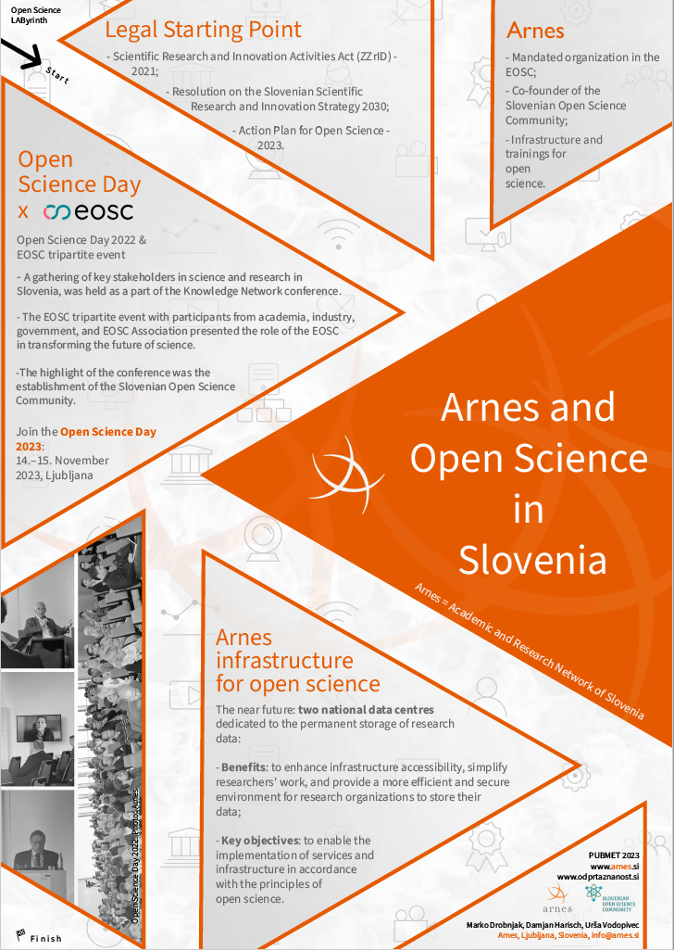
Why Open Science?
Open Science can improve the quality, efficiency, and responsiveness of scientific research.
Open Science aims to increase access to scientific research and data for everyone.
The FAIR principles are a set of guidelines used to promote Open Science.
The principles are focused on making research data findable, accessible, interoperable, and reusable.
Curabitur tempus felis in molestie faucibus. Sed ac diam vitae orci porttitor auctor non porttitor sem. Nam iaculis ullamcorper erat sed condimentum. Donec tempus urna sit amet iaculis tincidunt. Proin cursus est sit amet augue laoreet suscipit. Maecenas iaculis, tellus non finibus pellentesque, lorem enim volutpat felis, sit amet dictum diam ante ac ex. Sed mollis felis eget lorem cursus, luctus tincidunt nisl ullamcorper.

Slide 3
Legal Starting Point
The Law on Scientific Research and Development Activities (ZZrID) - 2021
The Resolution on the Slovenian Scientific Research and Innovation Strategy 2030 (ReZrIS30) - 2022
The Action Plan for Open Science – 2023

Slide 4
Arnes
Mandated organization in the EOSC
Co-founder of the Slovenian Open Science Community
Infrastructure and trainings for open science
Two National Data Centres

Slide 5
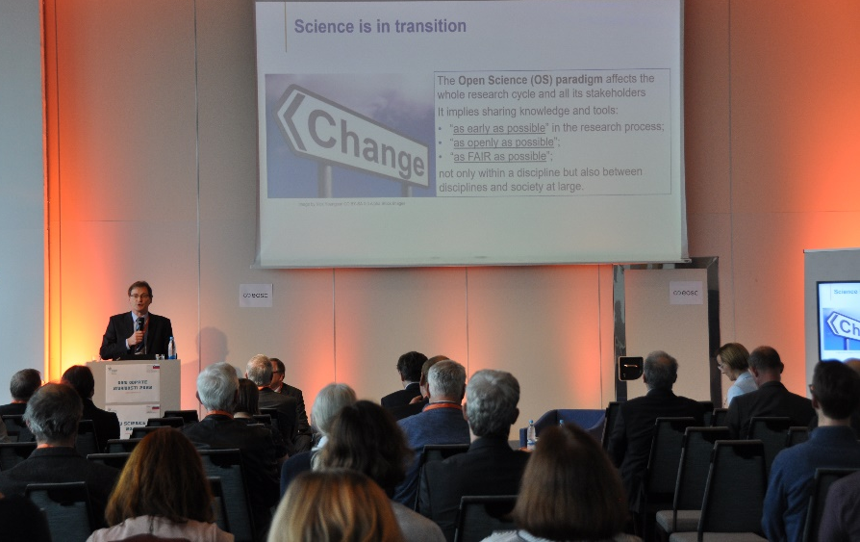
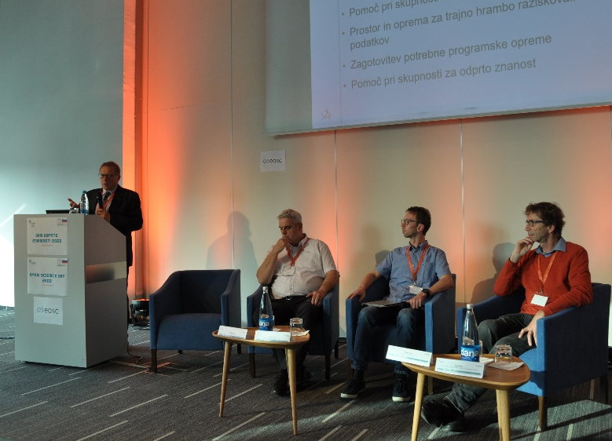
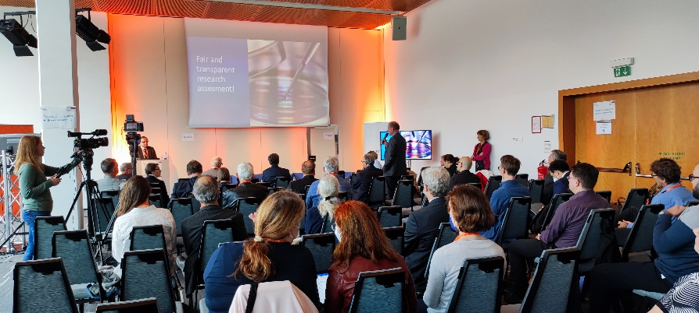
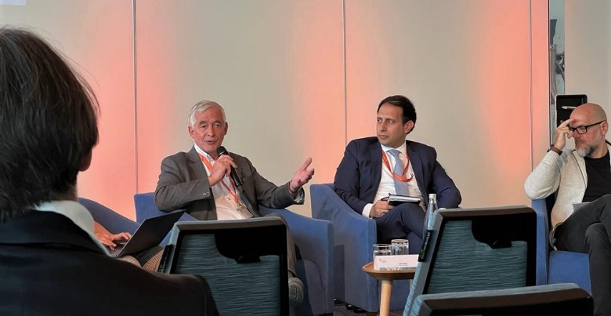
Open Science Day & EOSC Tripartite Event
Open Science Day 2023:14–15 November 2023, Ljubljana

Slide 6
See you at our poster!
Damjan Harisch: damjan.harisch@arnes.si www.odprtaznanost.si www.arnes.si

